Slide 1
Photonic MBQC in the NISQ Era
Yuxuan Zhang
PhD Intern
Jun. 29 2022

Slide 2
Metrics for quantum computers:
Scale: the number of qubits available
Speed: time cost per elementary gate action
Reliability: the ability to faithfully perform arbitrarily assigned tasks
Need to improve on all aspects!

Slide 3
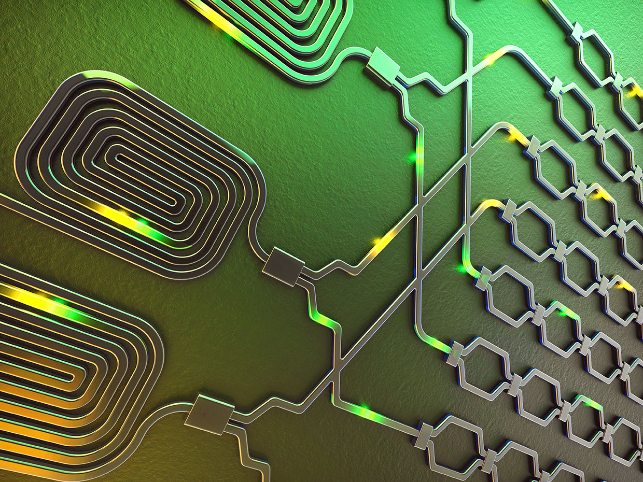
Imagine a QC with photons
Cheap to prepare
High clock rate
No cryogenesis required for cooling
Communication-ready
However, hard to store
Photons get lost!

Slide 4
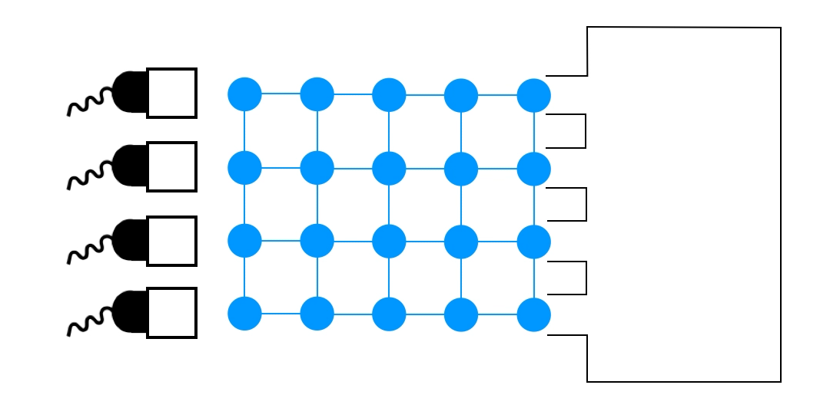
To overcome:
MBQC – generate photons and measure quickly
Error correcting codes that takes care of noise and/or erasure
Notes:
Linear optics: Beam splitter, phase shifter

Slide 5
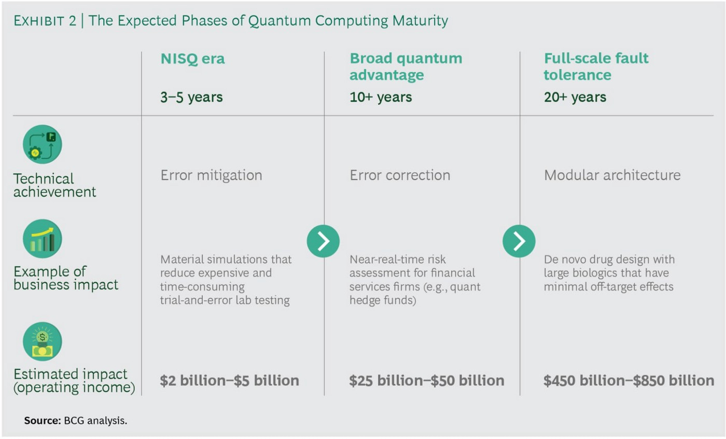

Slide 6
MBQC in the next 3-5 years
Assume there exists a technique that deals with erasure, and we’d like to know the effect of measurement noise
Notes:
100 million photons per second -> \tau= 10-100 nsec

Slide 7
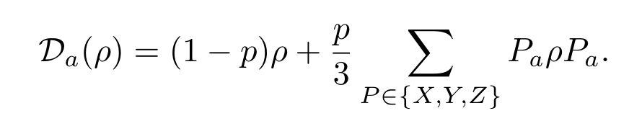

Measurement error
A general, hardware agnostic error model
Widely studied in quantum information community
Can be modified to accommodate biased noise sources

Slide 8
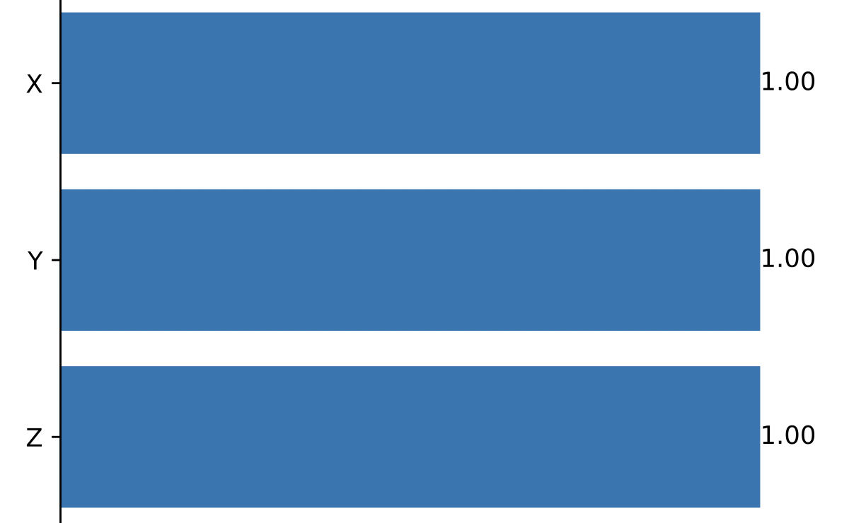

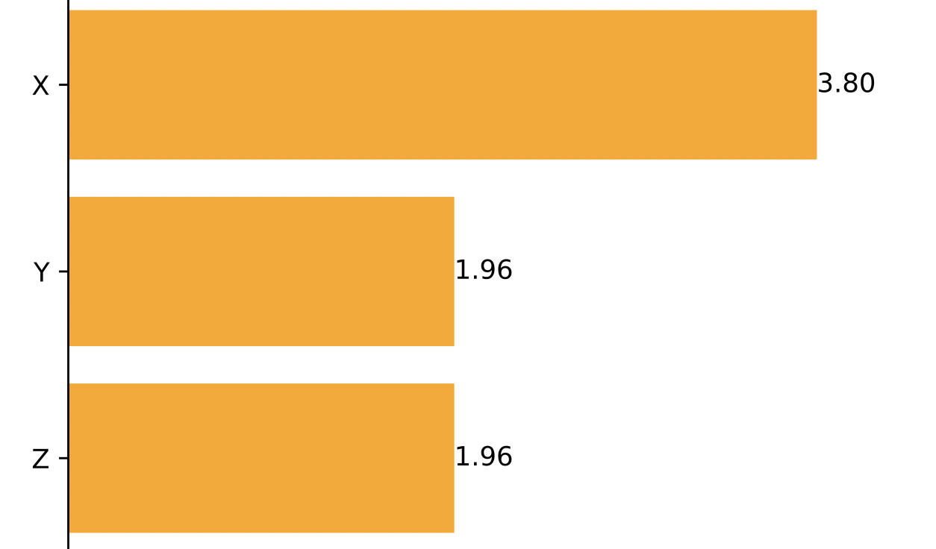
Case study: Hadamard Gate
Measurement pattern
Physical: an isotropic error model
Logical: a biased error model
Physical (top) and logical (bot) error rates (%)

Slide 9
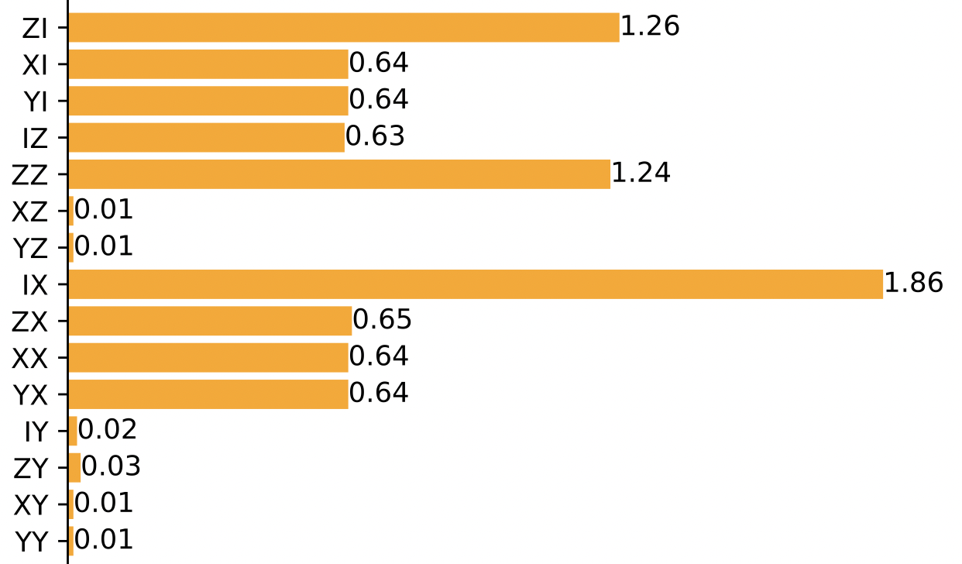
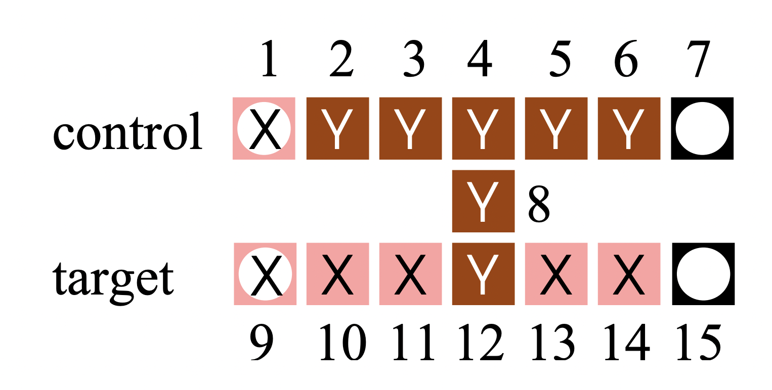
Case study: CNOT Gate
Effective CNOT error rate (in percent)
Measurement pattern
The effective logical error channel becomes even more non-uniform for CNOT!
Measurement error rate = 1%

Slide 10
Application: estimating quantum volume
A metric that measures the capabilities and error rates of a quantum computer
Introduced by IBM, widely accepted by companies like Quantinuum
Other benchmarking tools include randomized benchmarking, cross-entropy, etc.
p = 0.01%, comparable QV to cutting edge trapped-ion designs

Slide 11
What’s next:
Consider error channel in preparing cluster states
Introduce a package to convert a CBQC circuit to a MBQC circuit
Come up with more efficient compilers
Consider physically-oriented scenarios and provide guidance for near term experimentalists

